Slide 1
Advanced Modeling for Distribution Planning with OpenDSS
Instructor
Roger C. Dugan Sr. Technical Executive Sacramento, California June 22-23, 2017

Slide 2

Instructor
Roger C. Dugan, Life Fellow, IEEE
Roger is a Sr. Technical Executive with EPRI in Knoxville, Tennessee USA. He has over 45 years of combined experience in distribution engineering with EPRI, Electrotek Concepts, and Cooper Power Systems. He holds the BSEE degree from Ohio University and the Master of Engineering in Electric Power Engineering degree from Rensselaer Polytechnic Institute, Troy, NY. Roger has worked on many diverse aspects of power engineering over his career because of his interests in applying computer methods to power system simulation. Beginning with a student internship with Columbus and Southern Ohio Electric Co, his work has been focused on Distribution Engineering. He was elected a Fellow of the IEEE for his contributions in harmonics and transients analysis. Recently, he has been very active in distributed generation, particularly as it applies to utility distribution systems and distribution system analysis. He was the 2005 recipient of the IEEE Excellence in Distribution Engineering Award. He is coauthor of Electrical Power Systems Quality published by McGraw-Hill, now in its 3rd edition. He serves on the IEEE PES Distribution System Analysis Subcommittee and is active in the Distribution Test Feeders WG.

Slide 3
Scripting Basics – Large Circuits

Slide 4
Scripting Large Circuits
For small circuits, it is often sufficient to put all the scripts in a single file
Many of the IEEE test feeder examples are mostly in a single file
When you have large amounts of data, a more disciplined approach is recommended
Redirect Command
Redirects the input to another file
Returns to home directory
Compile Command
Same as Redirect except repositions home directory

Slide 5
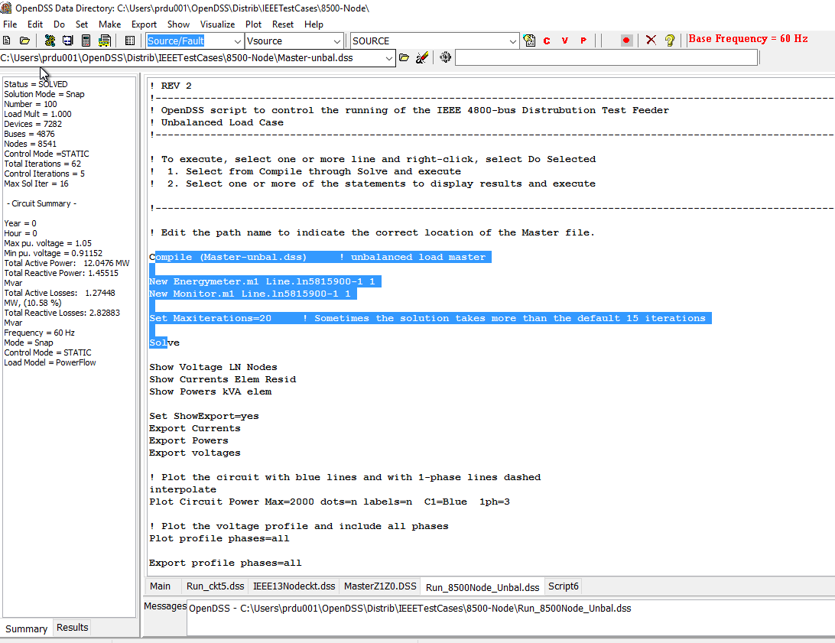
The OpenDSS Main Screen
Results Text Box
Solution Summary and Results
Selection to execute
Main Script Tab never goes away. Put some frequently-used commands here.
Active Script file
Tabs for script files

Slide 6
Using the Main Screen
You can switch between tabs and execute pieces of code from one window and then another
OpenDSS is always running and remains in the state after the last command until you tell it to do something else
OpenDSS.exe saves all windows on the main screen
They appear where you left them when you shut down
The next time you start up, you can resume your work
Values are saved to the Windows Registry

Slide 7
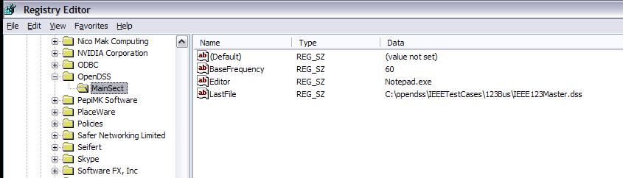
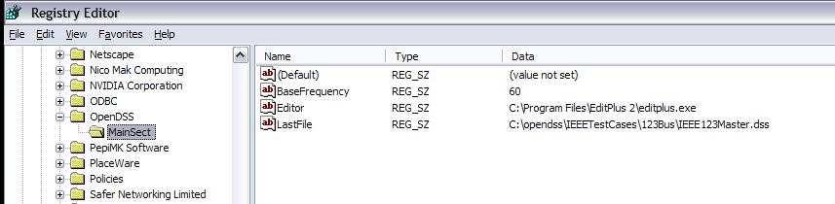
OpenDSS Registry Entries
Certain persistent values are saved to the Windows Registry upon exiting the program
Default Editor Setting
After Redefining

Slide 8
Organizing Your Script Files

Slide 9
A Common Sense Structuring of Script Files
Run_The_Master.DSS
“Compile” the Master file from here
Master.DSS
LineCodes.DSS
WireData.DSS
LineGeometry.DSS
Libraries
Put a “Clear” in here
Spectrum.DSS
LoadShape.DSS
Transformers.DSS
Lines.DSS
Circuit Definition
Make a separate folder for each circuit
Loads.DSS
Etc.

Slide 10
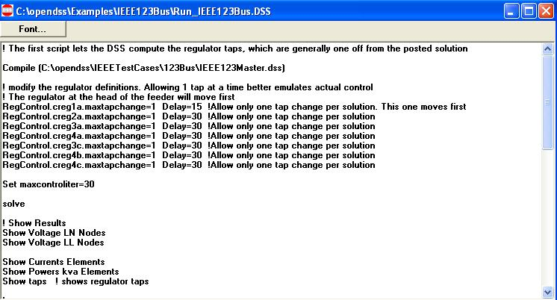
Organizing Run Scripts
Based on 123-bus IEEE Test Feeder
Compiles the Circuit Description
Override Some Property Settings and/or Define Some Additional Circuit Element
Change an option
Solve Snapshot Power Flow
Selected Results Display

Slide 11
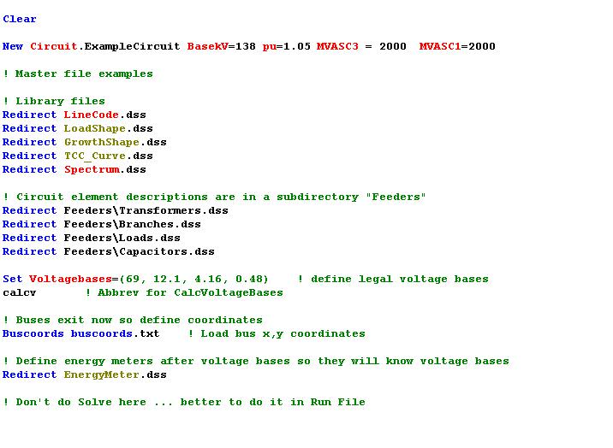
Organizing Your Master File
So Compile Doesn’t Fail
General Library Data
Circuit Elements for this Model
Let OpenDSS Define the Voltage Bases
(You can do this explicitly with SetkVBase command)

Slide 12
Example: IEEE 8500-Node Test Feeder
Load and exercise the IEEE 8500-Node Test Feeder Circuit – an example of a large circuit

Slide 13
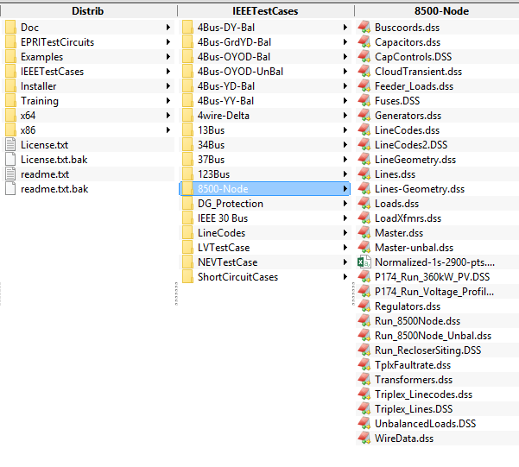
Location of the IEEE 8500-Node Test Feeder Files

Slide 14
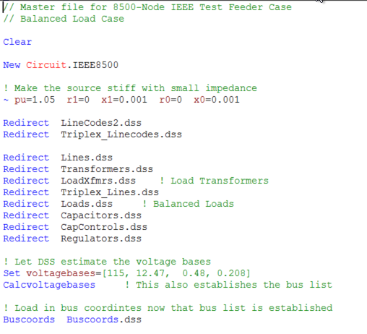
Master File for IEEE 8500-Node Test Case

Slide 15
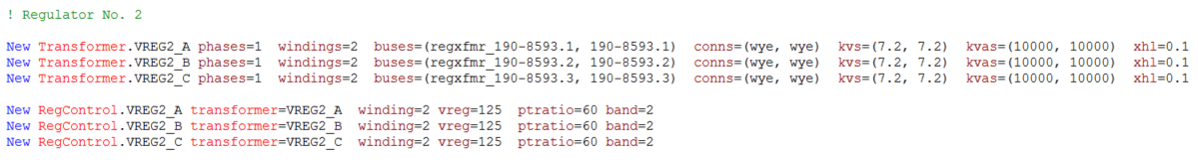
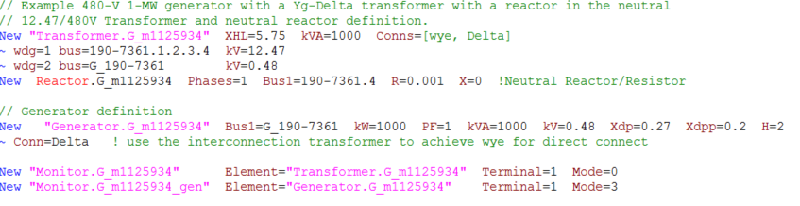
Snippets of Circuit Script Files (they are large)

Slide 16
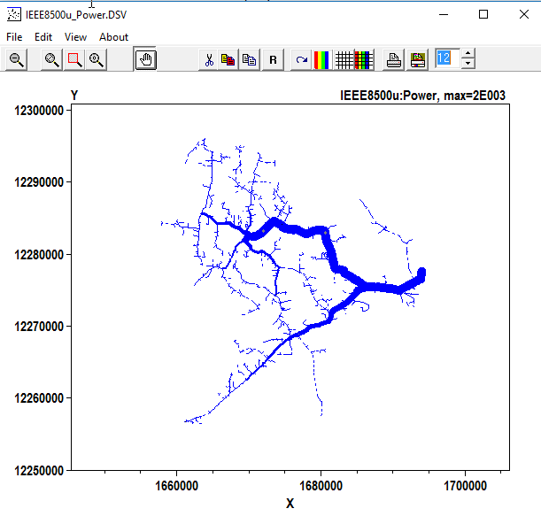
Circuit Plot
Plot Circuit Power Max=2000 dots=n labels=n C1=Blue 1ph=3

Slide 17
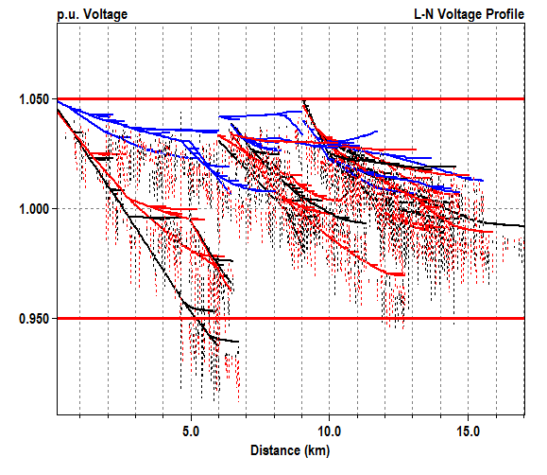
Voltage Profile Plot
Plot profile phases=all
Secondary Drops

